Slide 1

Object – Oriented Programming
Iksan Bukhori, M.Phil.

Slide 2
Topic 4: Class Attributes and Class Methods
Most Materials in this slide are taken from a video by freecodecamp.org channel:
Object Oriented Programming with Python - Full Course for Beginners

Slide 3
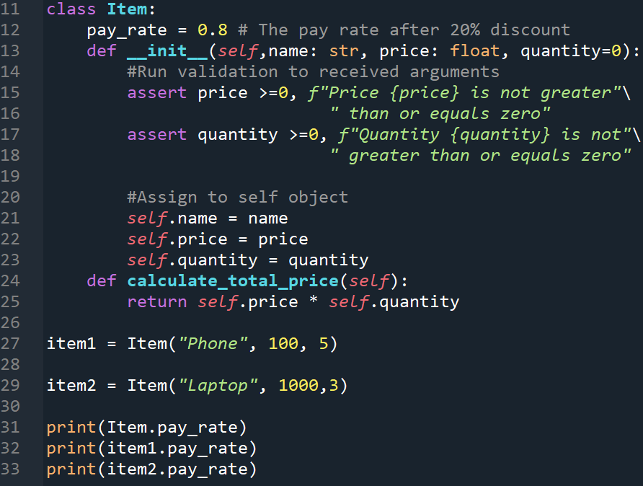
Class Attributes: Pay rate
Say you want to add discount attribute which is supposed to be applied for all instances of Item class
Pay attention to line 31-33 where class attribute can be called from either the class itself (Item) or its instances (item1 or item2)
This is because when an instance tries to access attribute, it will try to access instance attribute of that name. If there is no such attribute, it will try to see if there is class attribute with such name
To understand this better try to use __dict__ magic attributes on both the class and the instance

Slide 4
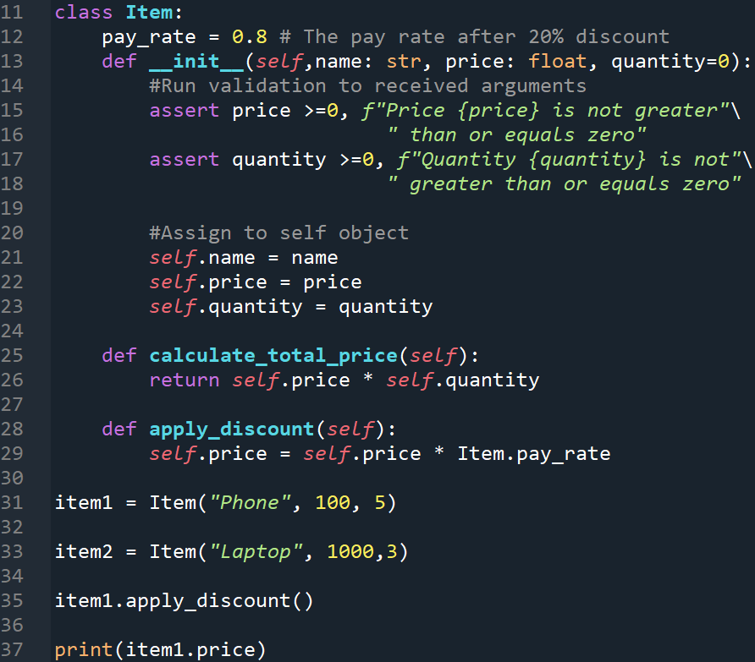
Applying discount on our program
Let’s create a new method called apply_discount()
Pay attention to line 29 where class attribute pay_rate should be called from the class itself (Item) specifically
This is because you can access the class attributes either from the class or the object itself. So, we explicitly name the class when calling the attribute to make sure that the one we access is really the class attribute, not the instance attribute of the same name (in case you have another instance attribute with the same name as the class attribute)

Slide 5
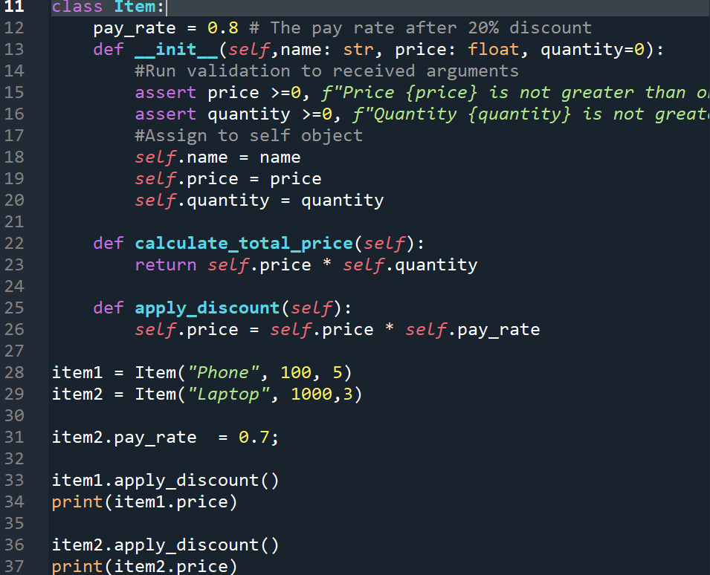
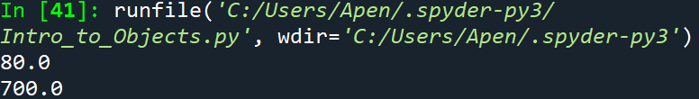
Applying different discount to different items
You can add instance attribute of the same name with the class attribute to the instance that you want to have different discount
Try to analyze why we change line 26 to use ‘self’ instead of Item!

Slide 6
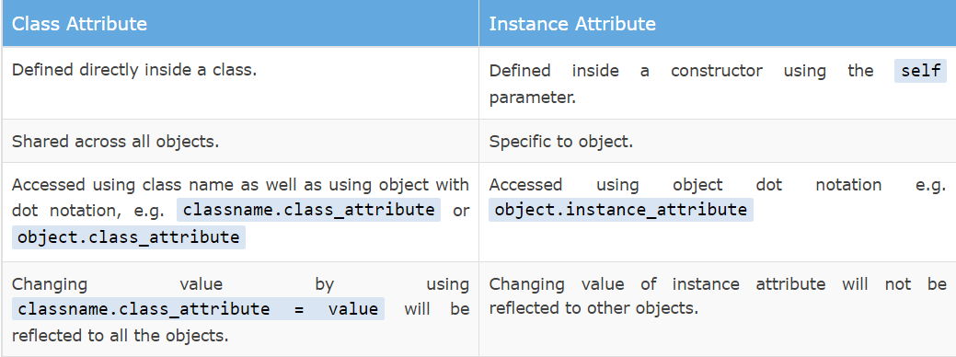
Class Attributes vs Instance Attributes
https://www.tutorialsteacher.com/articles/class-attributes-vs-instance-attributes-in-python#:~:text=Class%20attributes%20are%20the%20variables,are%20defined%20in%20the%20constructor.&text=Defined%20inside%20a%20constructor%20using%20the%20self%20parameter.

Slide 7
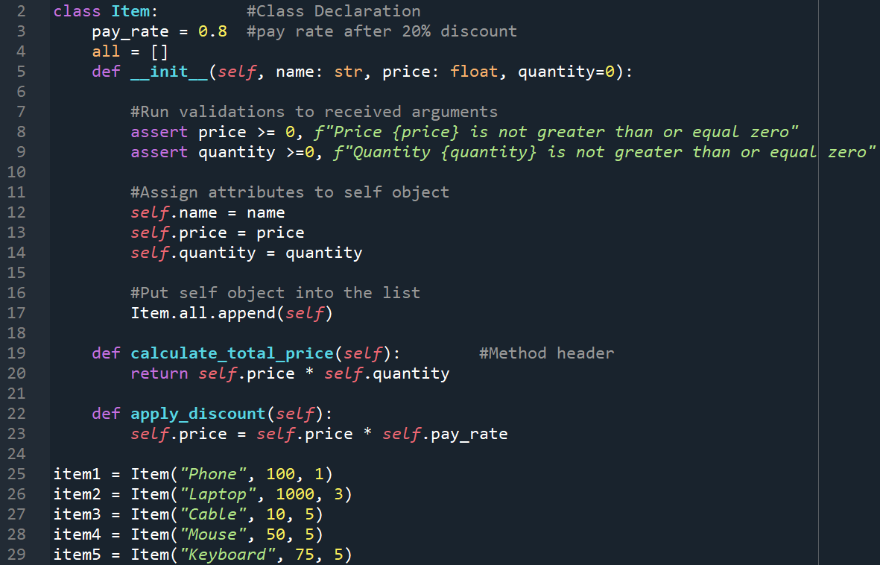

Class Attribute Example: List of all items
Suppose we want to be able to list the items (instances of Item class) in our store
Pay attention to how and why ‘all’ attribute is used as class attribute (line 4)
You can then enumerate the list, for example to see all the item names:

Slide 8
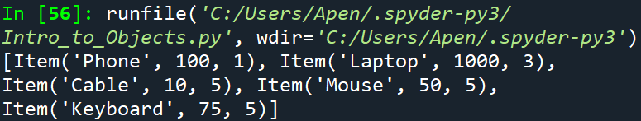
Extra: Magic method __repr__
Try to call the ‘all’ attribute from the class Item and print it.
The call Item.all returns the list of objects in unfriendly way. To fix this, we can use __repr__

Slide 9
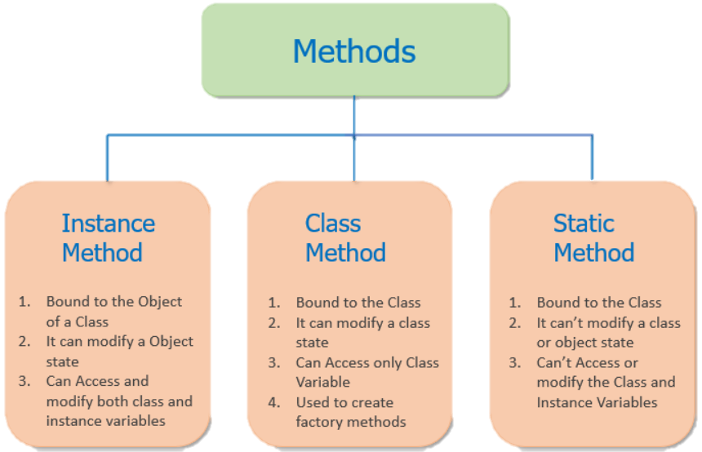
Class Method vs static method vs instance method
https://pynative.com/python-class-method-vs-static-method-vs-instance-method/

Slide 10

Class Method Example: Instantiate Outside Constructor
Let’s say that a particular group of Item object have the same price
Pay attention to how we use decorator on line 41 to indicate class method
Pay attention to how the class parameter is passed into class method instead of instance parameter
Pay attention to how we instantiate the object in the return statement (line 43)

Slide 11
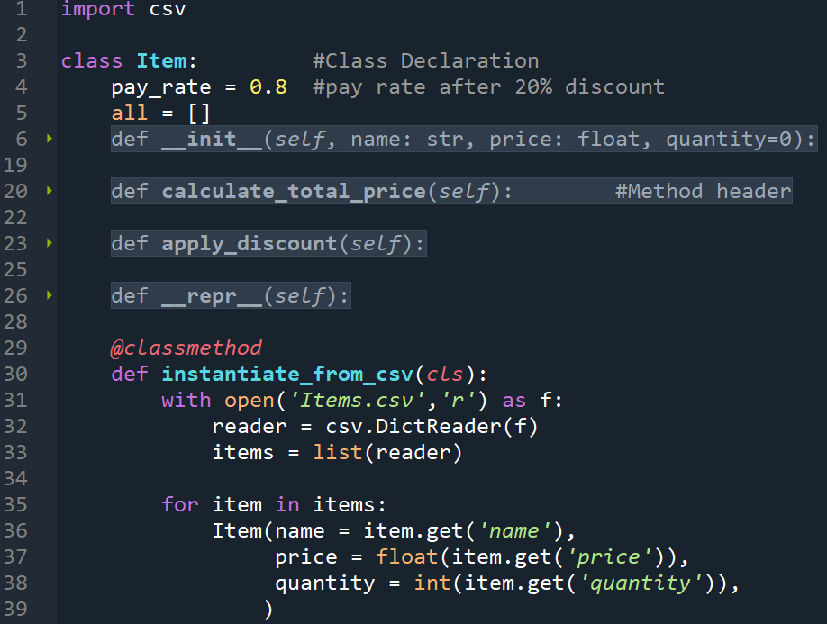
Class Method Example: Instantiate from Csv file
We could also enumerate from the csv file to instantiate from it
Pay attention to import statement
Pay attention to how we open, read, and make a list from the csv file (line 30-33)
In the for loop, pay attention how we instantiate Item objects one by one

Slide 12
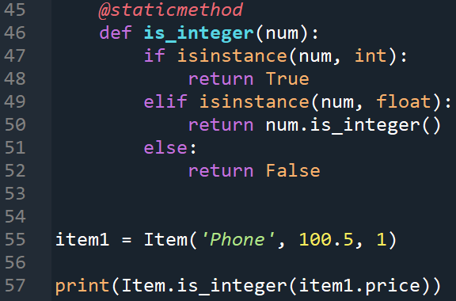
Static Method Example: Check if a number is integer

Slide 13
Access Modifier in Python
Public Attribute: Just the name of the attribute
Private Attribute: Append double underscore (__) in the front of the attribute name
Protected Attribute: Append single underscore (_) in the front of the attribute name

Slide 14
Access Modifier in Python: Name Mangling
Python has the principle of “We’re all adult here. We know what we are doing”
Python does not support the strict access modifier for private and protected like in other programming languages (Java, C, etc.)
Instead it uses name mangling to prevent direct access of the attribute
You can, however force the access by abusing this name mangling, though this is highly discouraged
Appending underscores employ this name mangling technique which has a main purpose to tell the programmer from where the access to the attribute should be done
https://www.geeksforgeeks.org/name-mangling-in-python/

